Slide 1
Constructors in C++
Constructors are functions of a class that are executed when new objects of the class are created.
The constructors have the same name as the class and no return type, not even void.
They are primarily useful for providing initial values for variables of the class.
The two main types of constructors are default constructors and parameterized constructors.

Slide 2
Default Constructors
Default constructors do not take any parameters.
If a default constructor is not provided by the programmer explicitly, then the compiler provides a implicit default constructor.
In that case, the default values of the variables are 0.

Slide 3
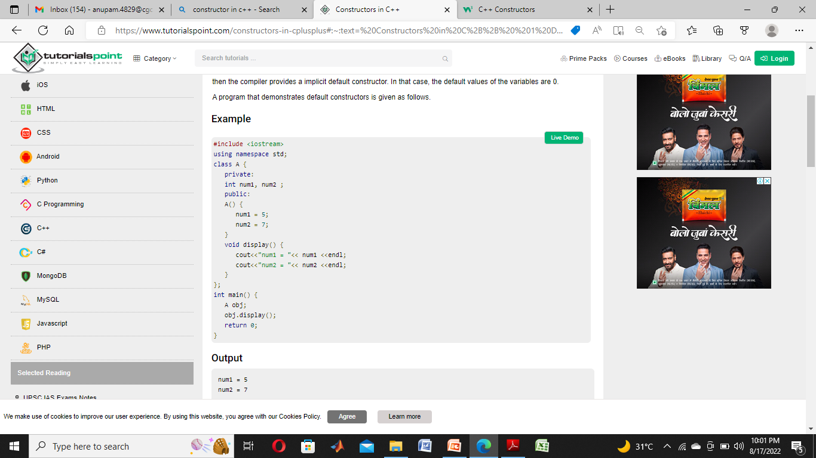

Slide 4
Parameterized Constructors
The parameterized constructors can take arguments to initialize an object when it is created.
Parameters are added to a parameterized constructor just like they are added to a normal function.
The parameterized constructors can be called implicitly or explicitly.

Slide 5
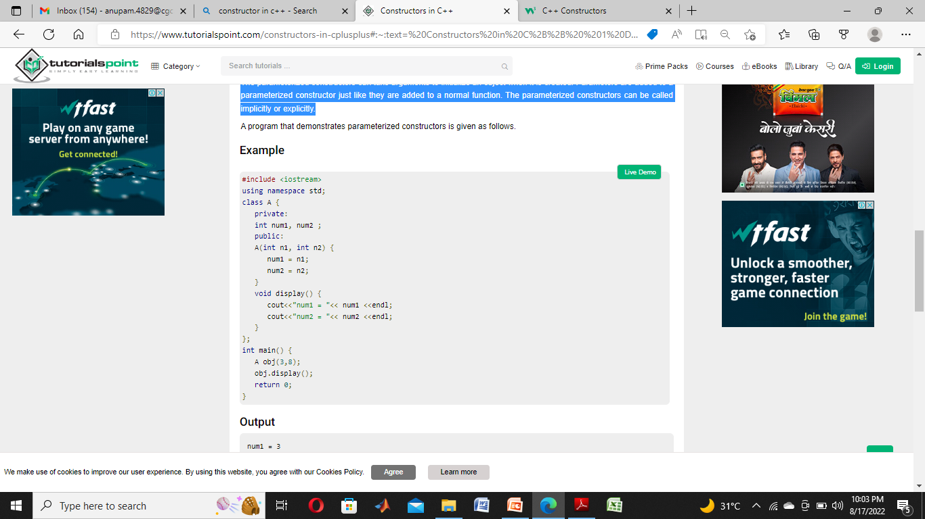

Slide 6
Destructor
Destructor is an instance member function which is invoked automatically whenever an object is going to be destroyed.
A destructor is the last function that is going to be called before an object is destroyed.
Destructor is also a special member function like constructor. Destructor destroys the class objects created by constructor.
Destructor has the same name as their class name preceded by a tiled (~) symbol.

Slide 7
It is not possible to define more than one destructor.
The destructor is only one way to destroy the object create by constructor. Hence destructor can-not be overloaded.
Destructor neither requires any argument nor returns any value.
It is automatically called when object goes out of scope.
Destructor release memory space occupied by the objects created by constructor.
In destructor, objects are destroyed in the reverse of an object creation.

Slide 8
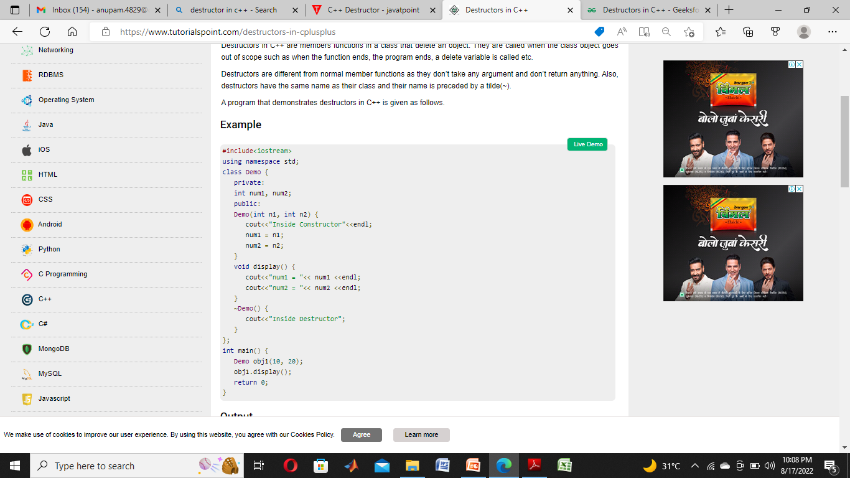

Slide 9
C++ Friend function
If a function is defined as a friend function in C++, then the protected and private data of a class can be accessed using the function.
By using the keyword friend compiler knows the given function is a friend function.
For accessing the data, the declaration of a friend function should be done inside the body of a class starting with the keyword friend.

Slide 10
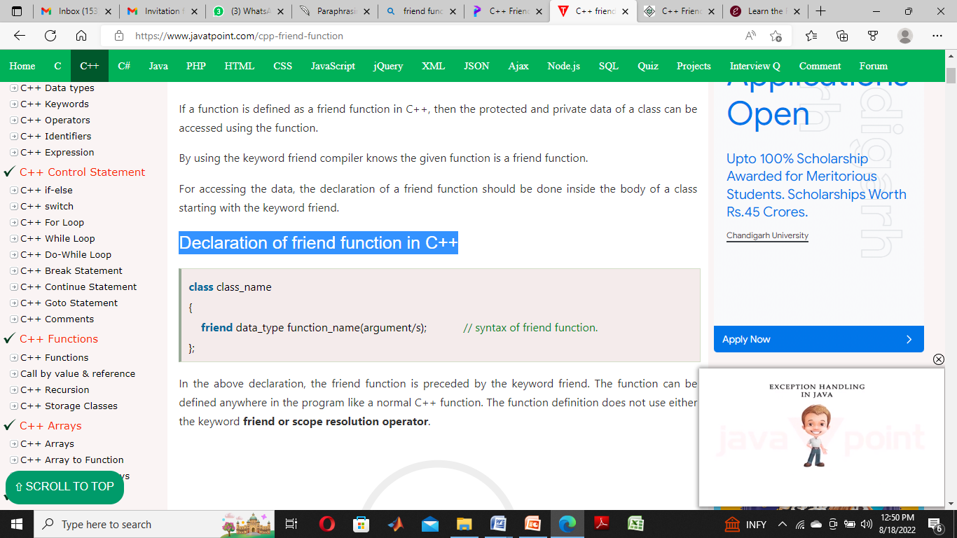
Declaration of friend function in C++
In the above declaration, the friend function is preceded by the keyword friend.
The function can be defined anywhere in the program like a normal C++ function.
The function definition does not use either the keyword friend or scope resolution operator.

Slide 11
Characteristics of a Friend function:
The function is not in the scope of the class to which it has been declared as a friend.
It cannot be called using the object as it is not in the scope of that class.
It can be invoked like a normal function without using the object.
It cannot access the member names directly and has to use an object name and dot membership operator with the member name.
It can be declared either in the private or the public part.

Slide 12
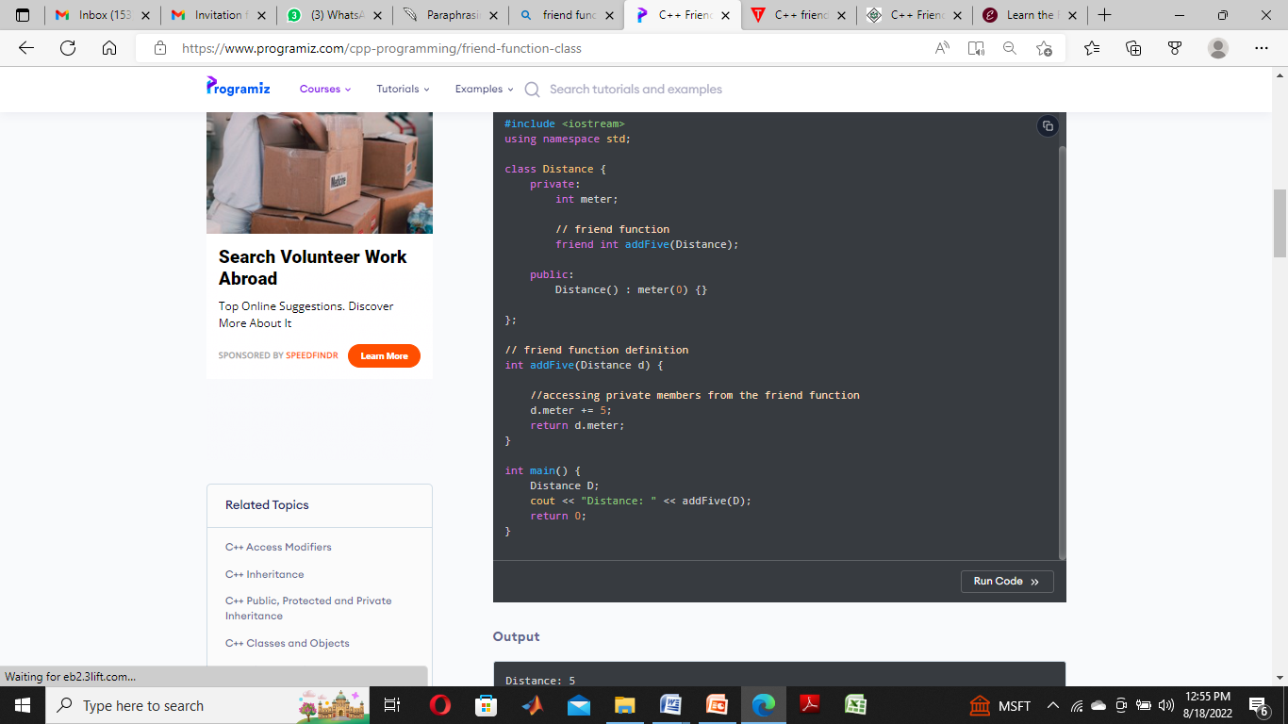
C++ friend function Example

Slide 13
Static data members in C++
Static data members are class members that are declared using static keywords.
A static member has certain special characteristics. These are:
Only one copy of that member is created for the entire class and is shared by all the objects of that class, no matter how many objects are created.
It is initialized before any object of this class is being created, even before main starts.
It is visible only within the class, but its lifetime is the entire program
Syntax
static data_type data_member_name;

Slide 14
The below program calls only B’s constructor, it doesn’t call A’s constructor.
The reason for this is simple, static members are only declared in a class declaration, not defined.
They must be explicitly defined outside the class using the scope resolution operator.
If we try to access static member ‘a’ without an explicit definition of it, we will get a compilation error.
For example, the following program fails in the compilation.

Slide 15
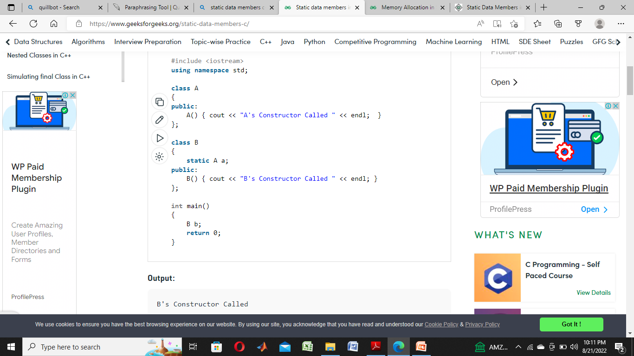
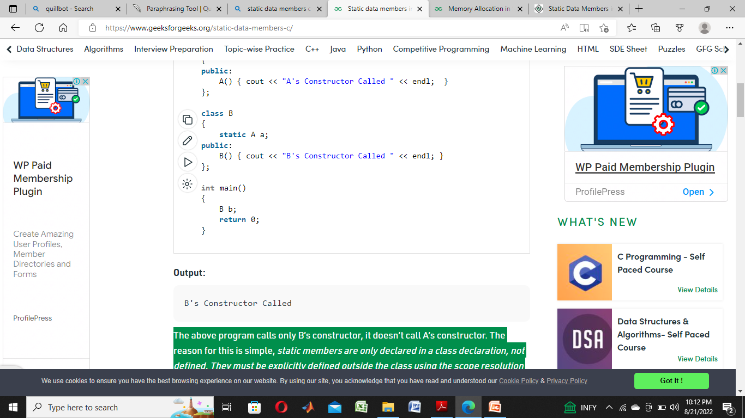

Slide 16
Note that the below program calls B’s constructor 3 times for 3 objects (b1, b2, and b3), but calls A’s constructor only once.
The reason is, static members are shared among all objects.
That is why they are also known as class members or class fields.
Also, static members can be accessed without any object, see the below program where static member ‘a’ is accessed without any object.

Slide 17
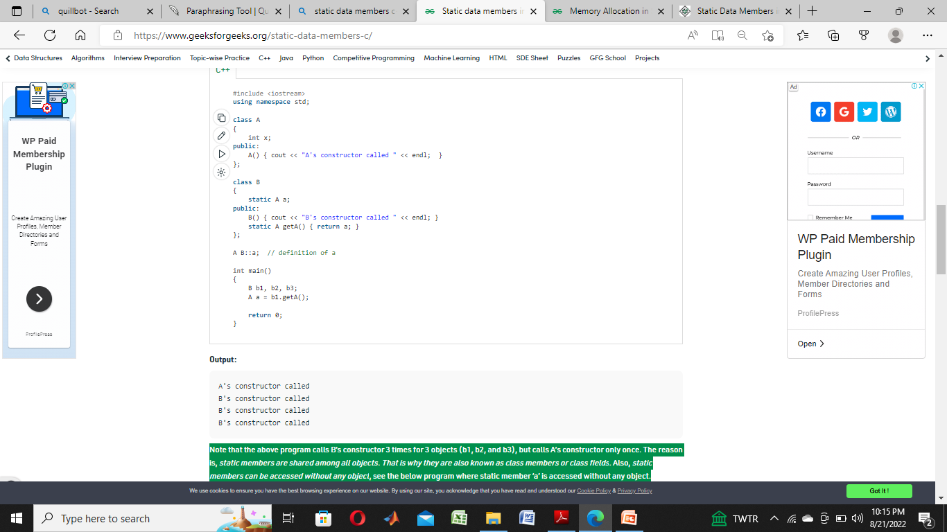

Slide 18
C++ Functions
A function is a block of code which only runs when it is called.
You can pass data, known as parameters, into a function.
Functions are used to perform certain actions, and they are important for reusing code: Define the code once, and use it many times.

Slide 19
Create a Function
C++ provides some pre-defined functions, such as main(), which is used to execute code. But you can also create your own functions to perform certain actions.
To create (often referred to as declare) a function, specify the name of the function, followed by parentheses ():
Syntax
void myFunction()
{
// code to be executed
}

Slide 20
Call a Function
Declared functions are not executed immediately. They are "saved for later use", and will be executed later, when they are called.
To call a function, write the function's name followed by two parentheses () and a semicolon ;
In the following example, myFunction() is used to print a text (the action), when it is called:

Slide 21
Example
Inside main, call myFunction():
// Create a function
void myFunction() {
cout << "I just got executed!";
}
int main() {
myFunction(); // call the function
return 0;
}
// Outputs "I just got executed!"

Slide 22
Function Declaration and Definition
A C++ function consist of two parts:
Declaration: the return type, the name of the function, and parameters (if any)
Definition: the body of the function (code to be executed)
void myFunction() { // declaration
// the body of the function (definition)
}
Note: If a user-defined function, such as myFunction() is declared after the main() function, an error will occur:

Slide 23
Array of Objects in C++
An array in C/C++ or be it in any programming language is a collection of similar data items stored at contiguous memory locations and elements can be accessed randomly using indices of an array.
They can be used to store the collection of primitive data types such as int, float, double, char, etc of any particular type.
To add to it, an array in C/C++ can store derived data types such as structures, pointers, etc. Given below is the picture representation of an array.

Slide 24
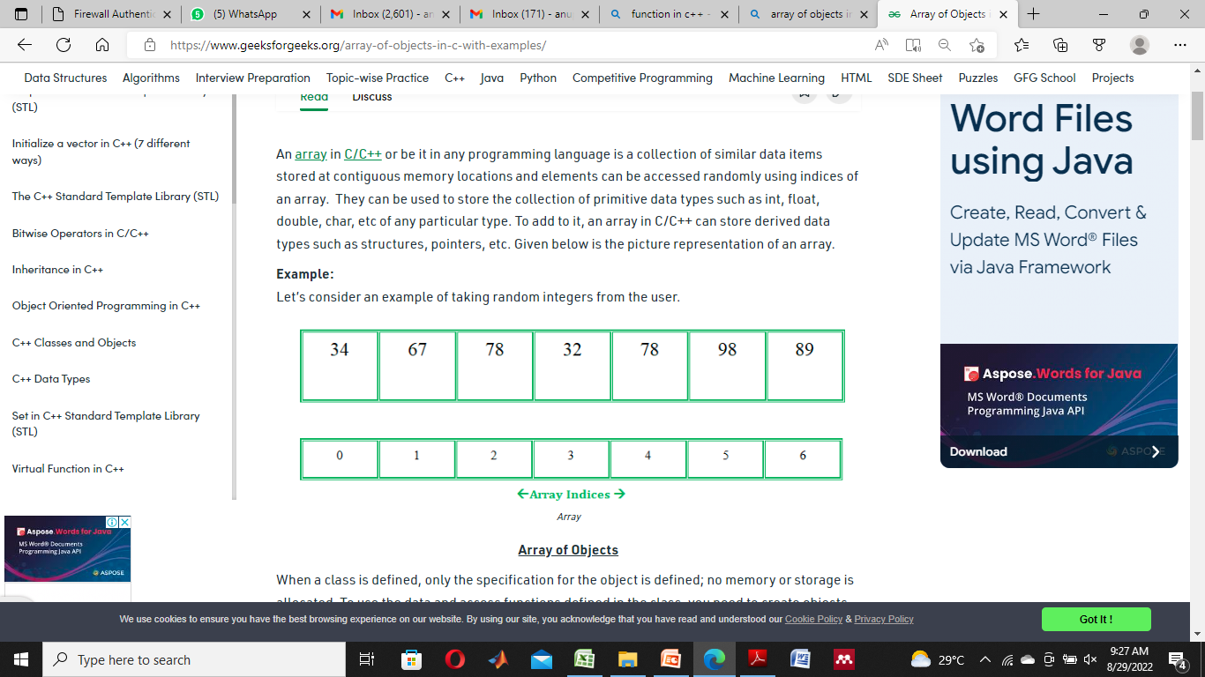

Slide 25
Array of Objects
When a class is defined, only the specification for the object is defined; no memory or storage is allocated.
To use the data and access functions defined in the class, you need to create objects.
Syntax:
ClassName ObjectName[number of objects];
The Array of Objects stores objects. An array of a class type is also known as an array of objects.

Slide 26
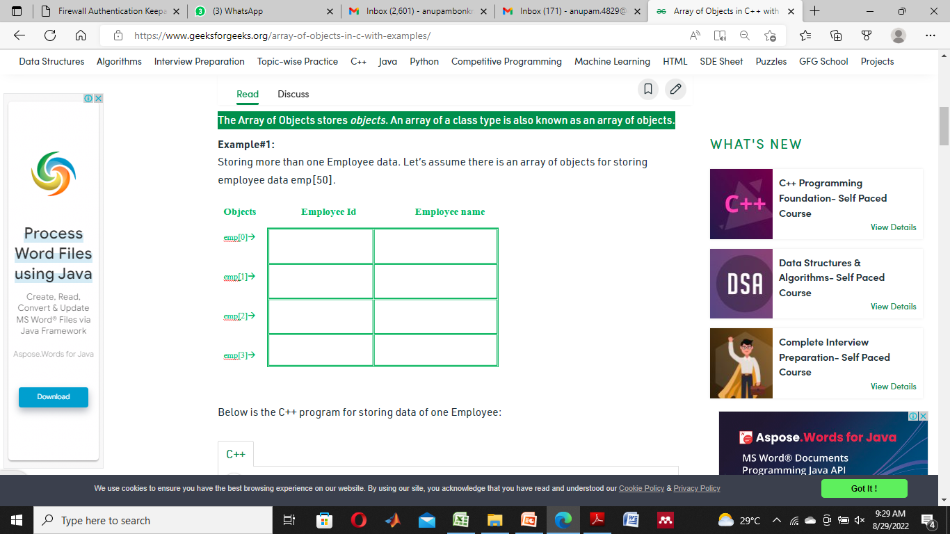

Slide 27
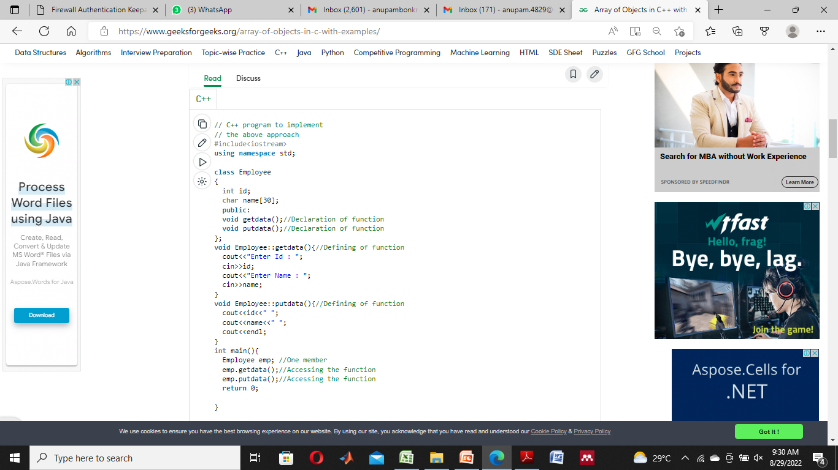
C++ program for storing data of one Employee:

Slide 28
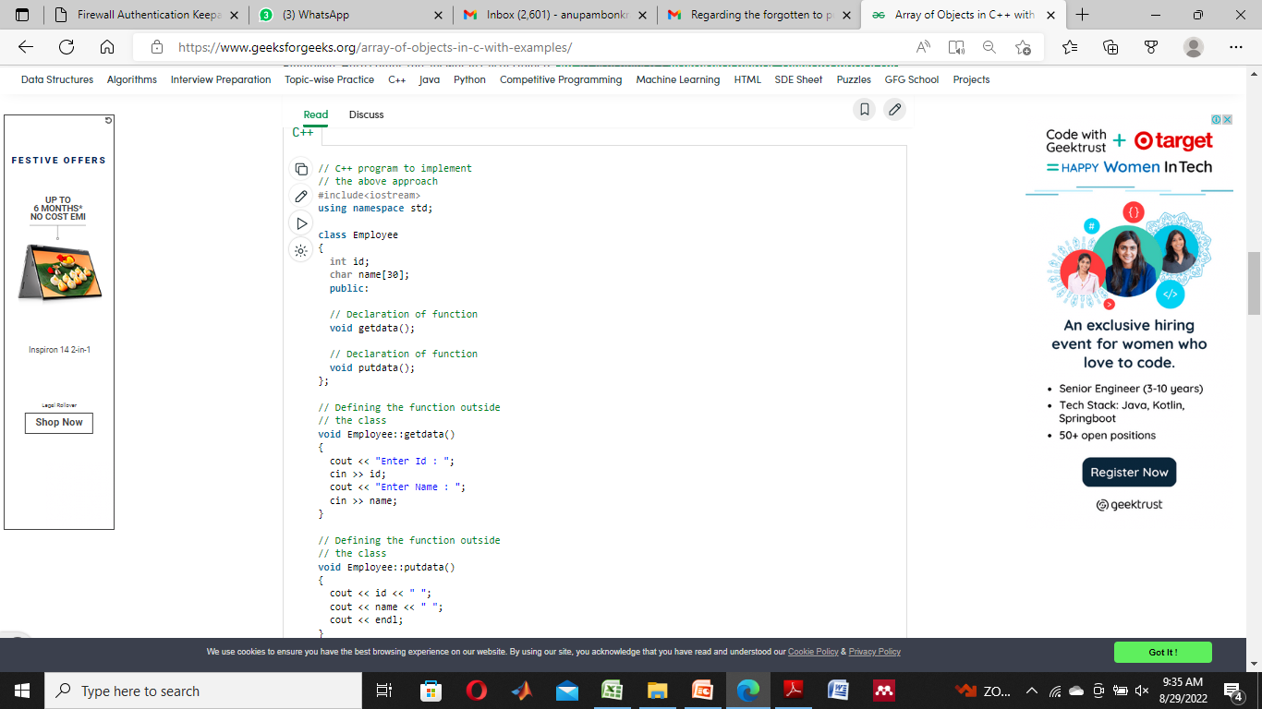
An array of objects can be used if there is a need to store data of more than one employee.

Slide 29
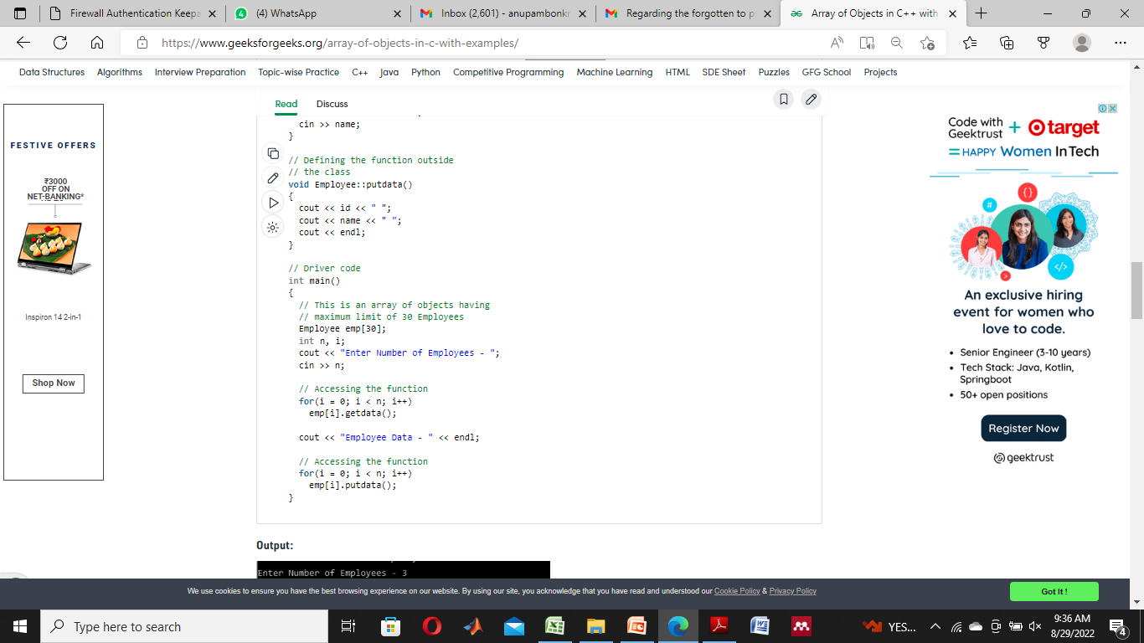

Slide 30
C++ Pointers to Objects
You can access an object either directly, or by using a pointer to the object.
To access an element of an object when using the actual object itself, use the dot operator.
To access a specific element of an object when using a pointer to the object, you must use the arrow operator.
To declare an object pointer, you use the same declaration syntax that you would use for any other pointer type.

Slide 31
Example
The next program creates a simple class called My_Class, defines an object of that class, called ob, and defines a pointer to an object of type My_Class, called p.
It then illustrates how to access ob directly, and how to use a pointer to access it indirectly.

Slide 32
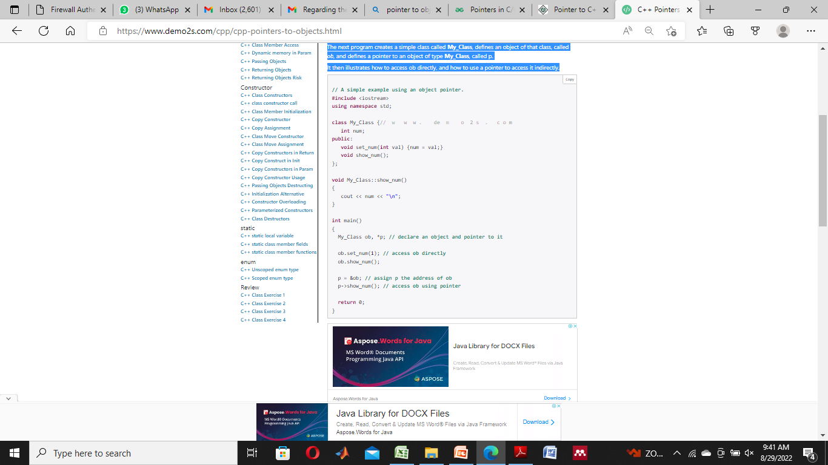

Slide 33
C++ this Pointer
In C++ programming, this is a keyword that refers to the current instance of the class. There can be 3 main usage of this keyword in C++.
It can be used to pass current object as a parameter to another method.
It can be used to refer current class instance variable.
It can be used to declare indexers.

Slide 34
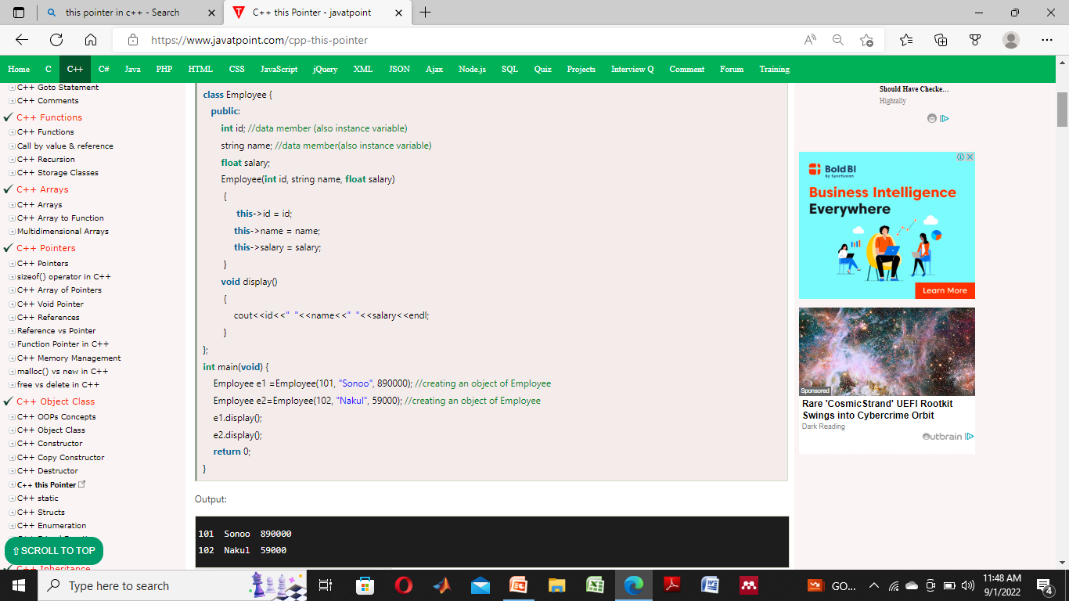
C++ this Pointer Example

Slide 35
Reference Parameters in C++
The call by reference method of passing arguments to a function copies the reference of an argument into the formal parameter.
Inside the function, the reference is used to access the actual argument used in the call. This means that changes made to the parameter affect the passed argument.

Slide 36
To pass the value by reference, argument reference is passed to the functions just like any other value.
So accordingly you need to declare the function parameters as reference types as in the following function swap(), which exchanges the values of the two integer variables pointed to by its arguments.

Slide 37
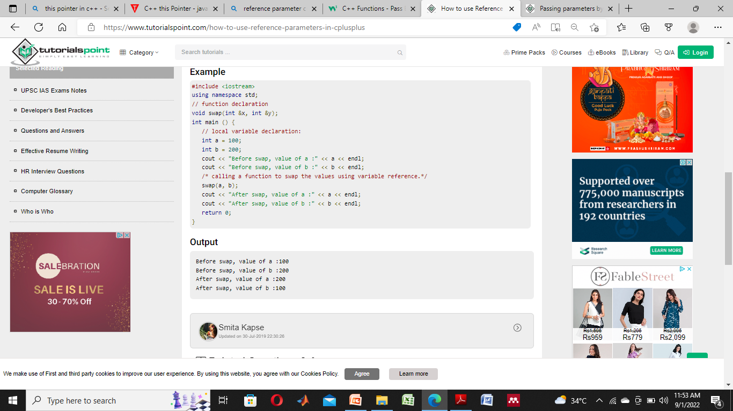
Example

Slide 38
C++ Copy Constructor
A copy constructor is a member function that initializes an object using another object of the same class.
A Copy constructor is an overloaded constructor used to declare and initialize an object from another object.
Copy Constructor is of two types:
Default Copy constructor: The compiler defines the default copy constructor. If the user defines no copy constructor, compiler supplies its constructor.
User Defined constructor: The programmer defines the user-defined constructor.

Slide 39
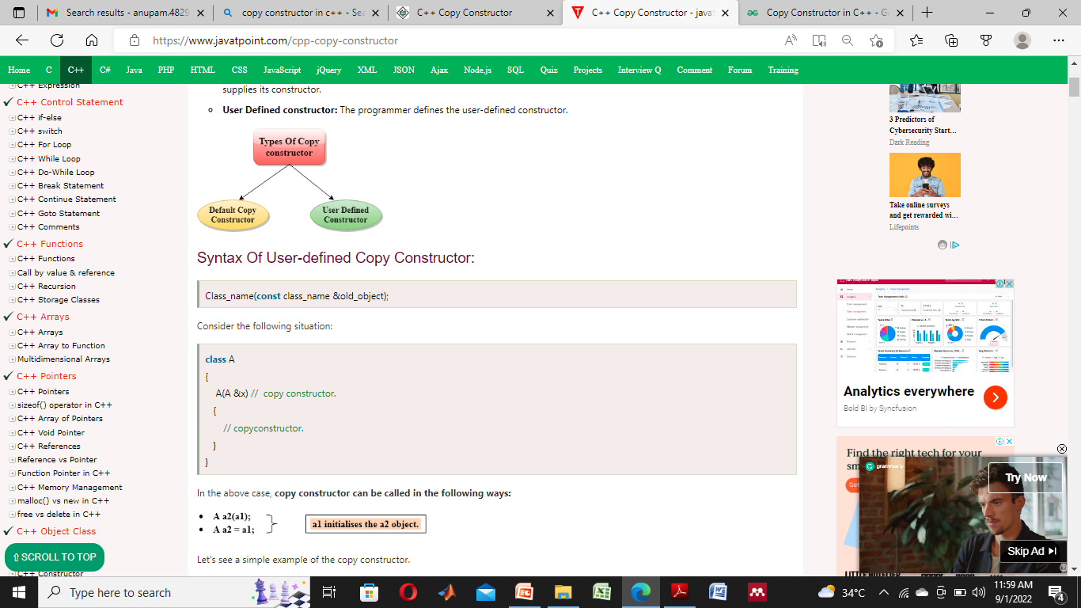
Syntax of User defined Copy constructor

Slide 40
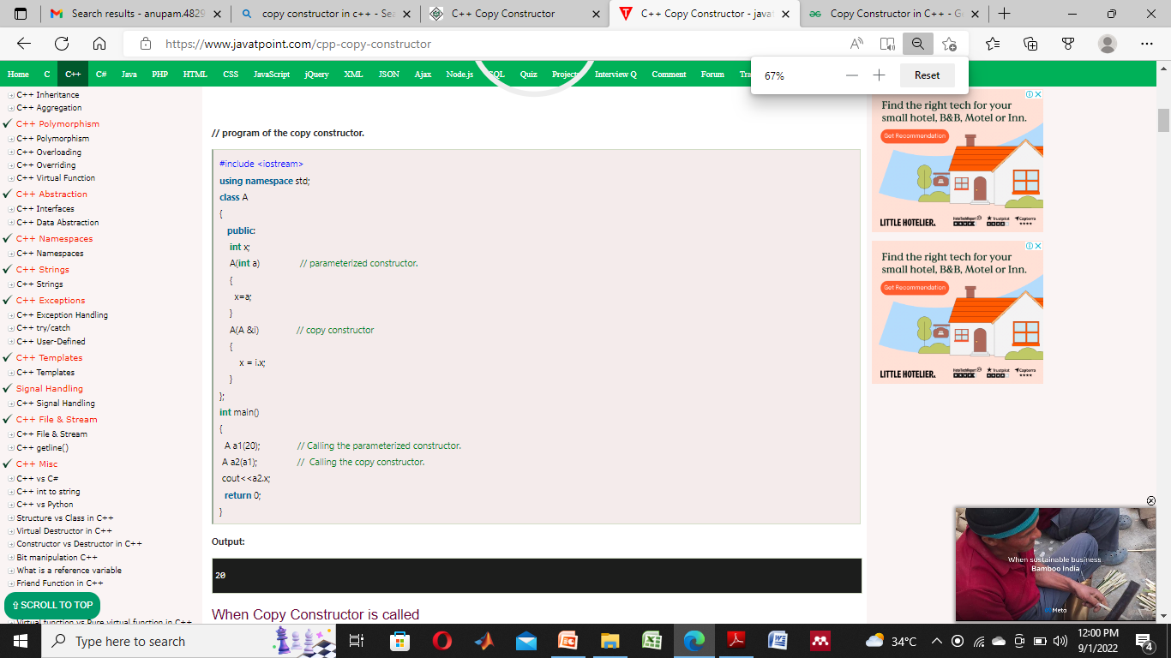
Example of Copy Constructor

Slide 41
When Copy Constructor is called
Copy Constructor is called in the following scenarios:
When we initialize the object with another existing object of the same class type. For example, Student s1 = s2, where Student is the class.
When the object of the same class type is passed by value as an argument.
When the function returns the object of the same class type by value.

Slide 42
Types of copies are produced by the constructor:
Shallow copy
Deep copy
Shallow Copy
The default copy constructor can only produce the shallow copy.
A Shallow copy is defined as the process of creating the copy of an object by copying data of all the member variables as it is.

Slide 43
Deep copy
Deep copy dynamically allocates the memory for the copy and then copies the actual value, both the source and copy have distinct memory locations.
In this way, both the source and copy are distinct and will not share the same memory location.
Deep copy requires us to write the user-defined constructor.

Slide 44
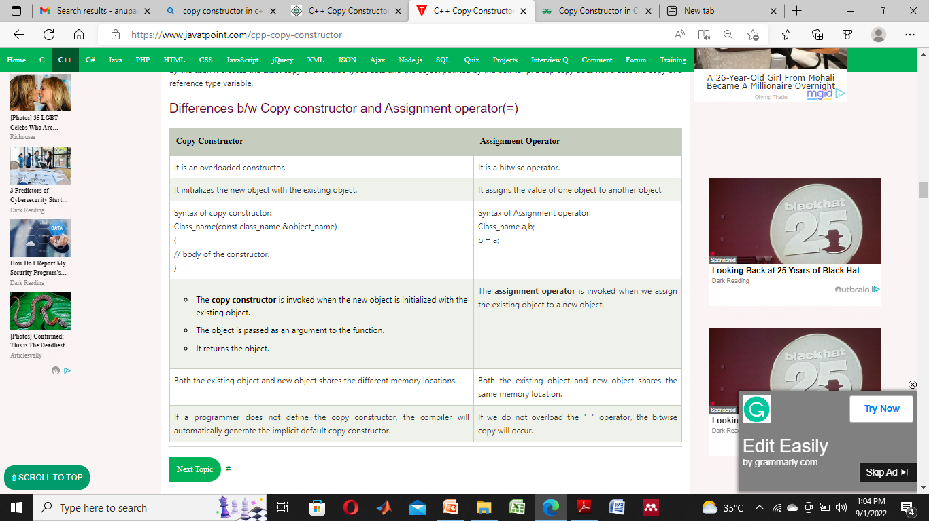

Slide 45
Operator Overloading
Operator overloading is a type of polymorphism in which a single operator is overloaded to give user defined meaning to it.
Operator overloading provides a flexibility option for creating new definitions of C++ operators.
There are some C++ operators which we can't overload.

Slide 46
The lists of such operators are:
Class member access operator (. (dot), .* (dot-asterisk))
Scope resolution operator (::)
Conditional Operator (?:)
Size Operator (sizeof)

Slide 47
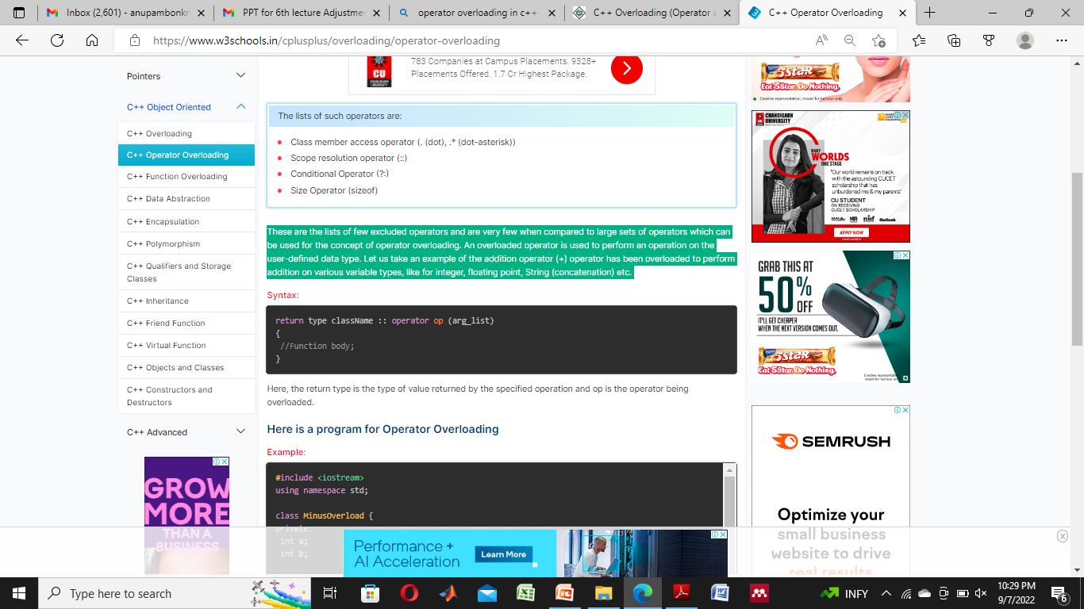
These are the lists of few excluded operators and are very few when compared to large sets of operators which can be used for the concept of operator overloading.
An overloaded operator is used to perform an operation on the user-defined data type.
Let us take an example of the addition operator (+) operator has been overloaded to perform addition on various variable types, like for integer, floating point, String (concatenation) etc.
Syntax:

Slide 48
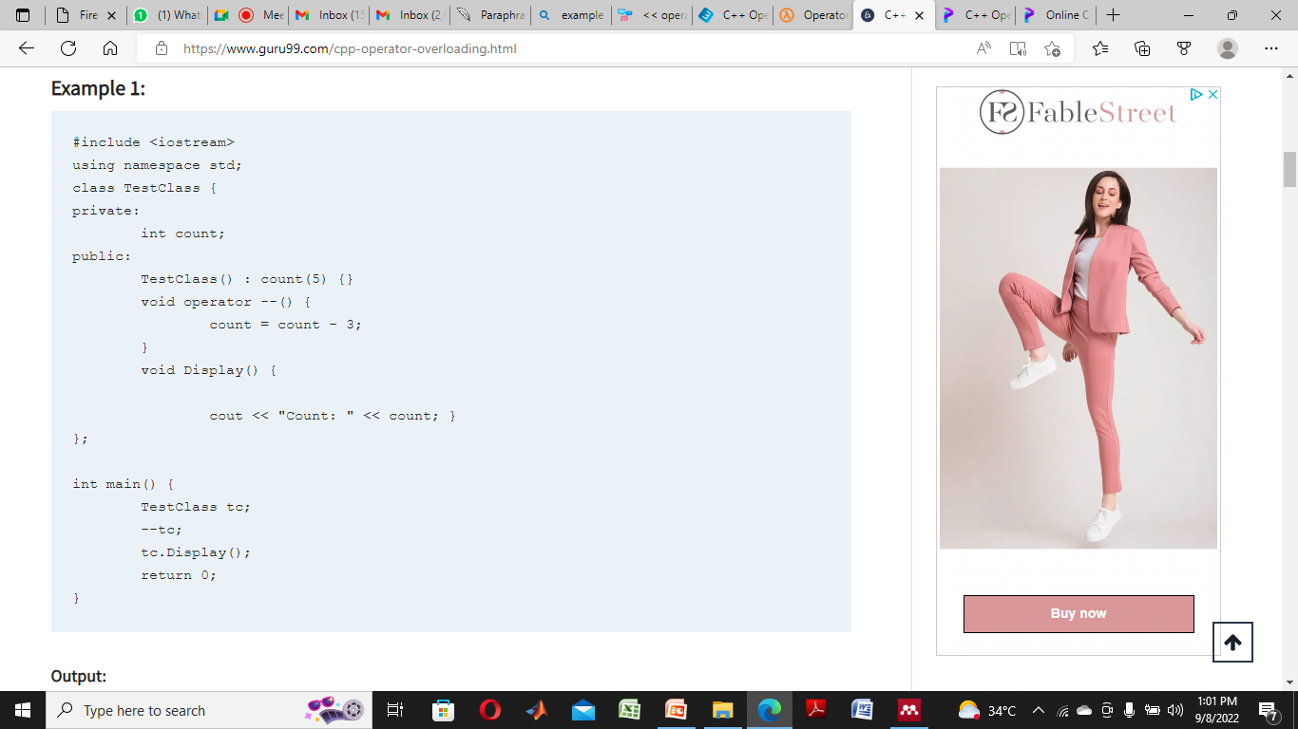
Example

